Slide 1
Hotel Management System
Presented by
Aishwarya MM PES1201802368 Suma J PES1201802415
Shraddha B PES1201802434 Sunitha M PES1201802414

Slide 2
Introduction
It is the knowledge age, truly a time when knowledge is power.
More so than ever before, organizations including hotels all over the world are focusing on knowledge as a key resource
Hotels are now using knowledge to gain and sustain a competitive advantage.
Investments in Knowledge Management System(KMS)in the hotel industry have become more of a necessity because the market in which hotels operate is now globalized and the world‟s economies

Slide 3
Purpose
The main purpose of my exercise is perform each employee’s activity in
Computerized way rather than manually which is time consuming
Room activities very safely,
Assign a room according to customer’s checkout of a computer
Releasing the room and finally compute the bill in short time.

Slide 4
Existing features
Room Detail Functions
Modification to Room assigned
Check-in and check-out Functions
Sign-up of New customer
Room assigning related to customer’s need
Room Details
Individual customer Report.

Slide 5
ADVANTAGES OF PROPOSED SYSTEM
Saves time of customers in quickly reserving rooms.
The ability to book rooms anytime, from anywhere with Internet access.
Provides the information about hotel facilities.
Very secure.
User friendly

Slide 6
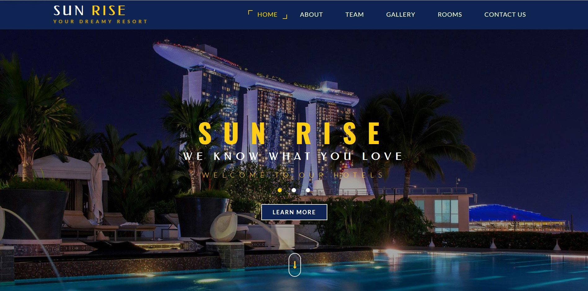
Home page

Slide 7
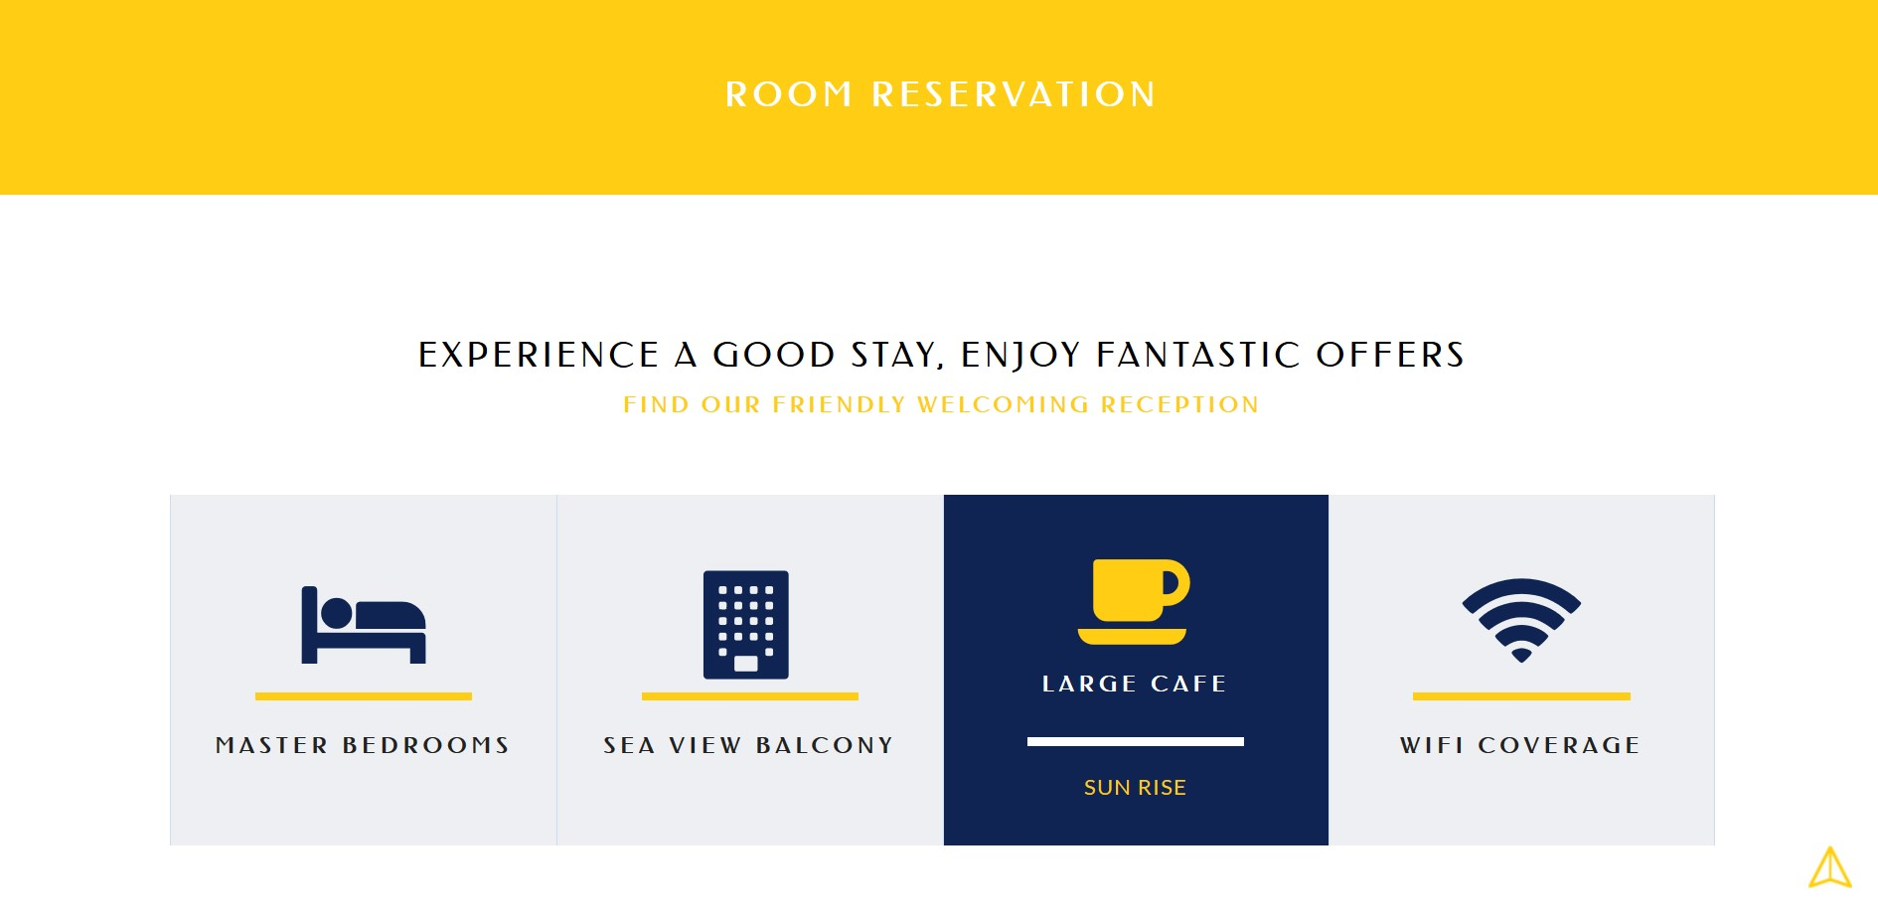
Room Reservation

Slide 8
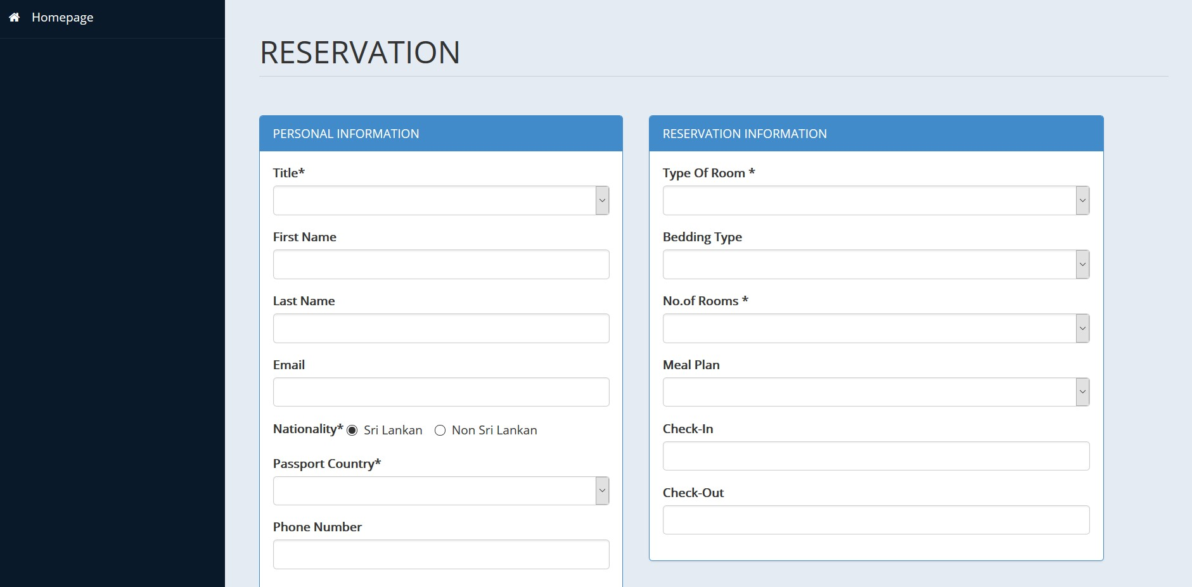

Slide 9
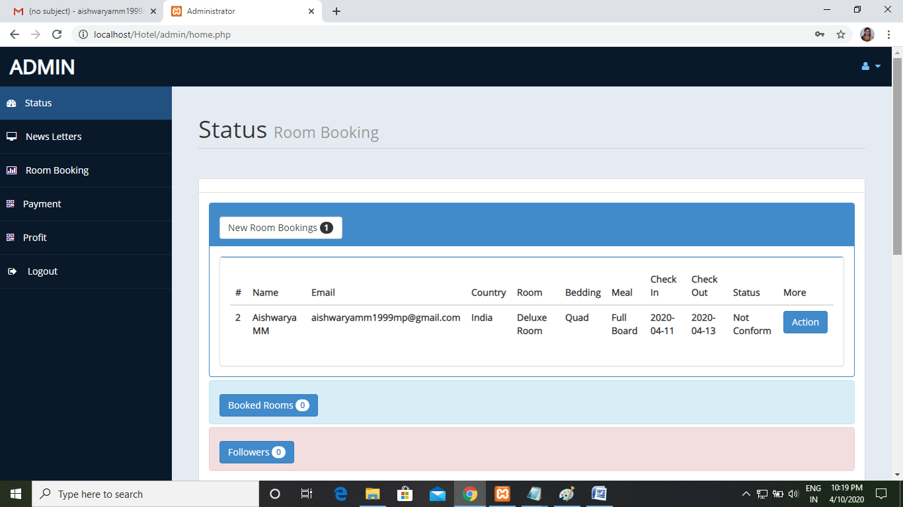

Slide 10
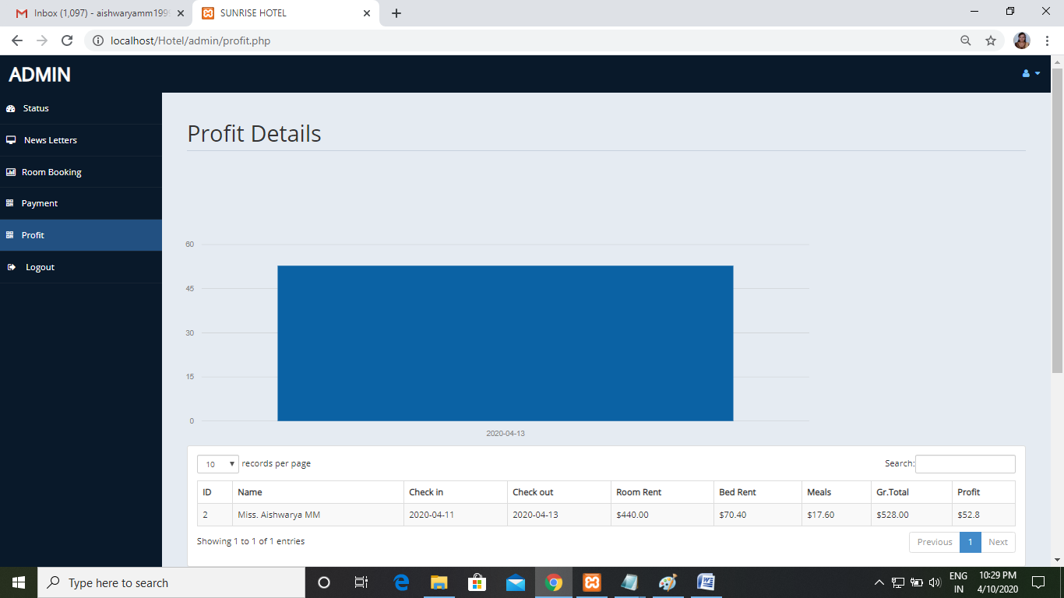

Slide 11
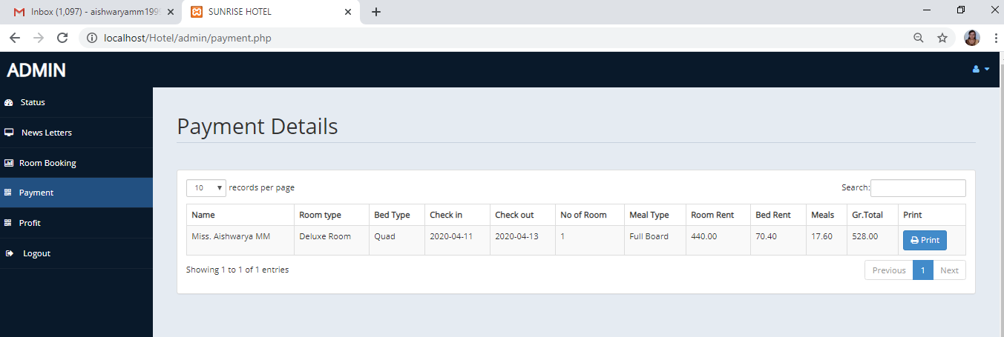
Payment Details

Slide 12
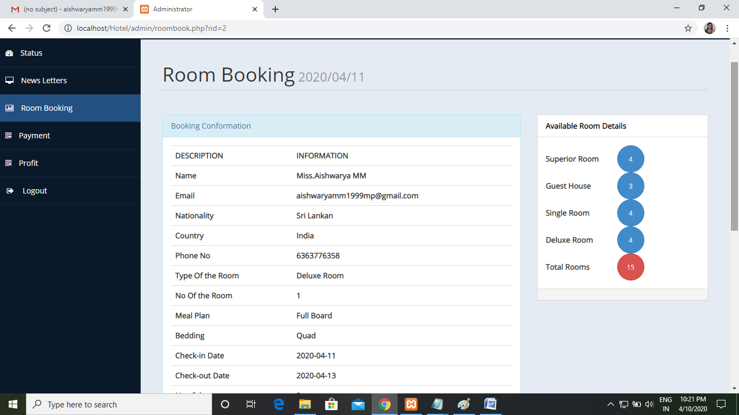

Slide 13
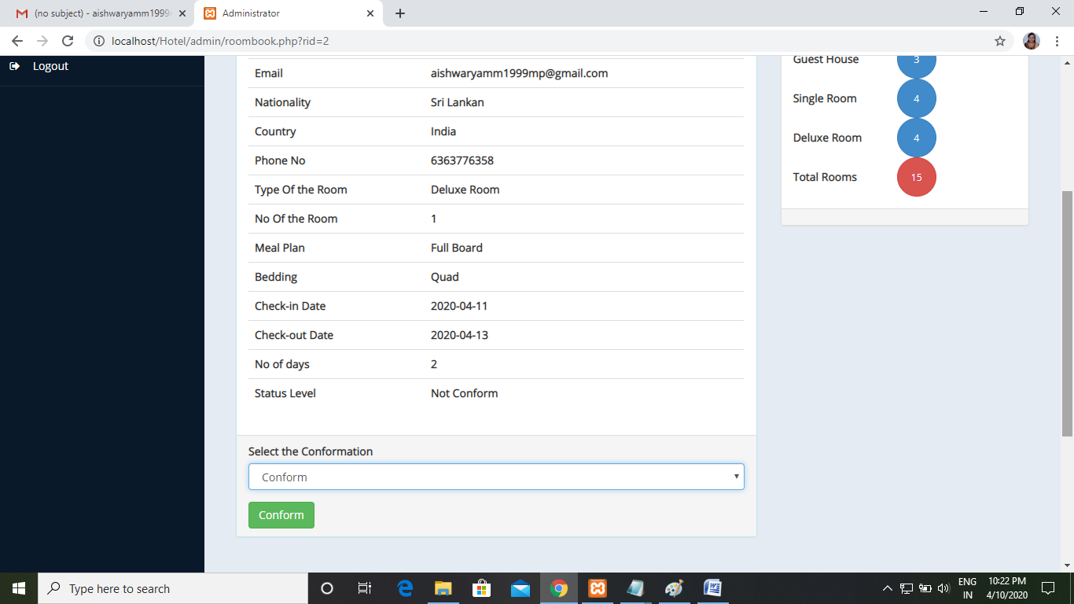

Slide 14
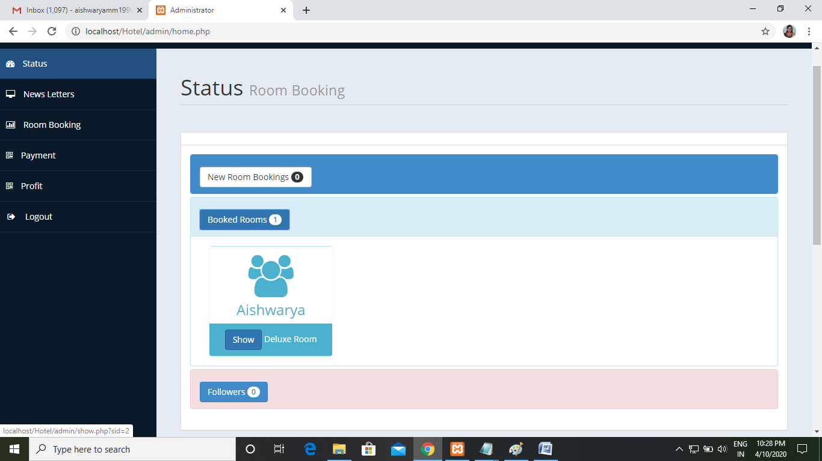
Status

Slide 15
Profit Details

Slide 16
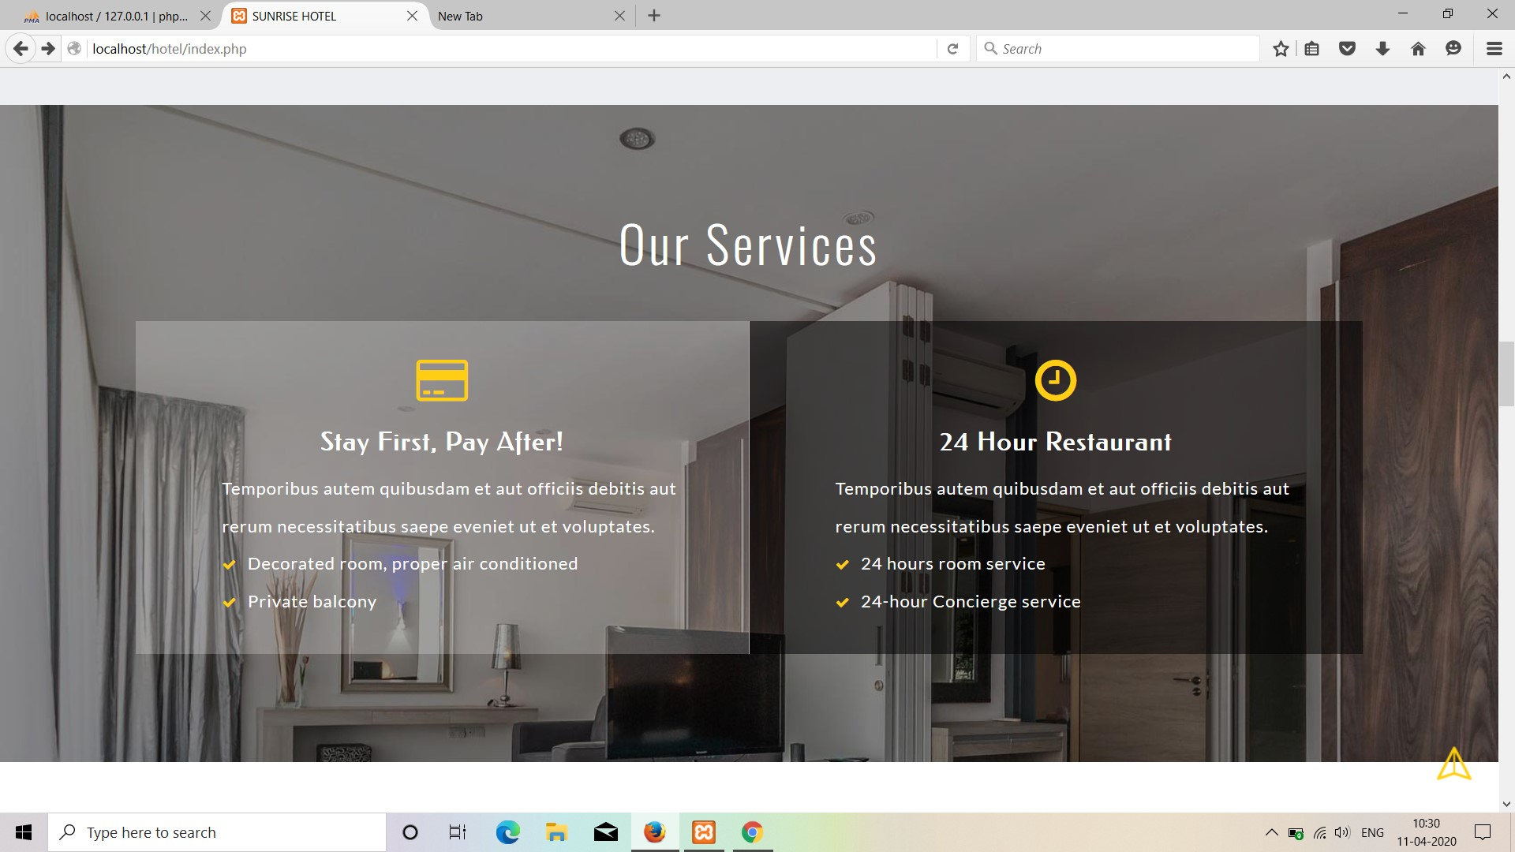

Slide 17
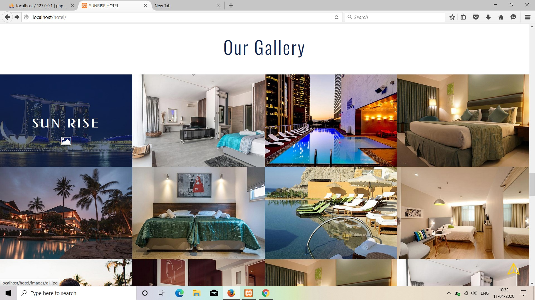

Slide 18
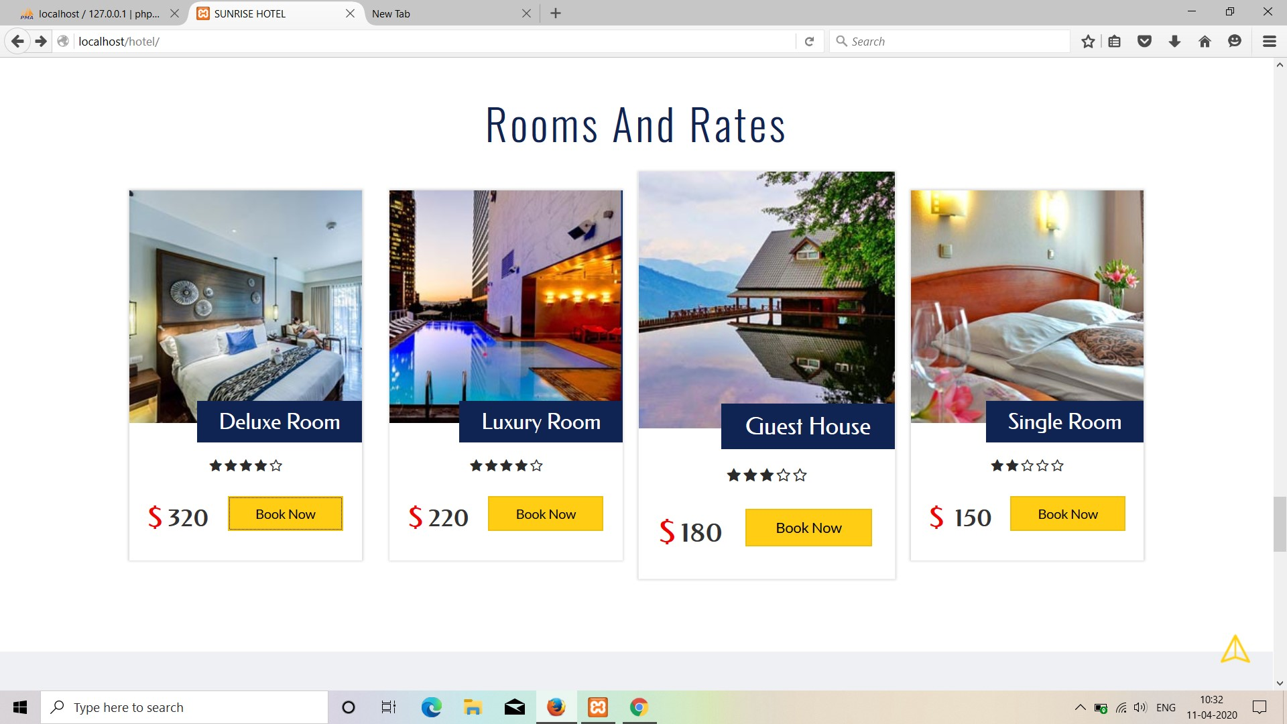
Rooms and Rates

Slide 19
THANK YOU

